Slide 1
PEYTON FOREST
PRINCIPAL’S REPORT
GO Team Meeting #2

Slide 2
TOPICS
School Start Update
Current Enrollment & Leveling
School Strategic Plan
Strategic Plan Overview
SMART Goals
GMAS Results

Slide 3
CURRENT ENROLLMENT

Slide 4
SY 2023 Enrollment: 391
SY 2022 Enrollment: 424
Change in Enrollment: -33
Notes:
· Change in enrollment was a decrease from 424 students to 391. A difference of 33 students. We lost one unit, however we did not lose any teachers. The vacant 5th grade position was used for leveling. Leveling did not impact teacher vacancies.

Slide 5
Staffing

Slide 6
Media Specialist - position filled
Ms. Tanisha Jackson

Slide 7
Art Teacher - position filled
Mr. Robert Brown

Slide 8
2nd Grade Teacher - vacancy

Slide 9
1-on-1 SPED Para - vacancy

Slide 10
2021-2025
STRATEGIC PLAN

Slide 11
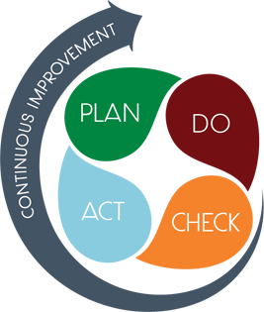
STRATEGIC PLAN SMART GOALS
Overview
  2022-2023 Priorities
    Literacy
    Numeracy
    Attendance

Slide 12
STRATEGIC PLAN SMART GOALS
Smart Goals
  By May 2023, students in grades 3-5 will increase ELA proficiency on GMAS from 14% to 19%.
Notes:
· Established an intervention team 3 weeks ago.
· Team are the “experts”
· Monitor usage daily
· Provide a report each Monday for me to review
· Teachers are notified when numbers are below 20 minutes daily
· Intervention team also provide coaching with small groups, use of resources, goal setting, reflection
· Weekly incentives to students for meeting their goal

Slide 13
STRATEGIC PLAN SMART GOALS
Smart Goals
  By May 2023, students in grades 3-5 will increase Math proficiency on GMAS from 14% to 19%.
Notes:
· Tier I instruction
· Small group personalized support
· Family engagement and awareness of student data
· Full-time intervention teacher, MTSS specialist and district disproportionality specialist
· Weekly PL to support tier I instruction, specifically student engagement.
· Small group PL and coaching support

Slide 14
STRATEGIC PLAN SMART GOALS
Smart Goals
  By May 2023, K-5 attendance rate will improve from 89% to 95%.
Notes:
· Attendance team meets weekly
· Parents are called
· Attendance celebrations
o Pop-up parties
o ROAR rally medals
o Grade-level attendance trophies
Chronic Absenteeism
· Uses attendance tracker to send home alerts weekly
· Attendance Letters
· Homeroom teachers call home
· Attendance team call home
· Social Worker home visit

Slide 15
GEORGIA MILESTONES ASSESSMENT RESULTS

Slide 16
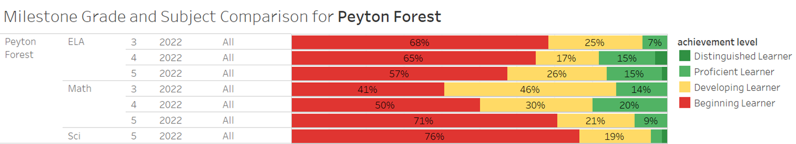

Slide 17
MAP FALL 2022 ASSESSMENT RESULTS

Slide 18
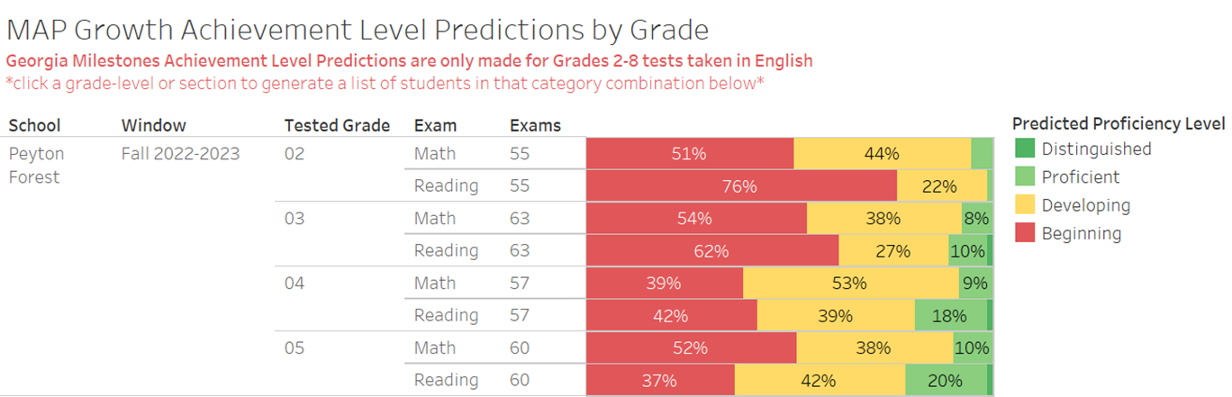

Slide 19
GLOWS & GROWS
GLOWS
GROWS
Care Team attendance communication (home visits, phone calls, attendance alerts, robo calls)​
ELA MAP growth proficiency increased in ELA from fall (13.4to spring from 13.4% to 16.9%​
MAP growth proficiency increased in Math from fall to spring 2.4% to 3.6%​
Weekly planning and Data Meeting Professional Learning Communities (PLC)​
K-5 daily intervention and enrichment​
Decrease in student attendance from 95.4% in 2019 to 89.6% ​ ​
Milestones ELA proficiency deceased from 24.1% to 14%​
Milestones Math proficiency decreased from 29.8% to 14%​ ​
Milestones Science proficiency decreased from 17.9% to 4.4%​ ​

Slide 20
QUESTIONS?

